Slide 1

Intern Presentation
Nishant Jinsiwale
Management Science and Integration Intern

Slide 2

Agenda
ABC Marketing ROI Forecast Pipeline
Automated Validation Process
Cross Platform Integration
Timeline
Takeaways
Conclusion

Slide 3



Introduction
Marketing ROI
Movies
TV Shows
New Businesses
Extract Methodology
Cross Platform Integration
SAS
Datasets
SAS/OR
Statistical Libraries

Slide 4
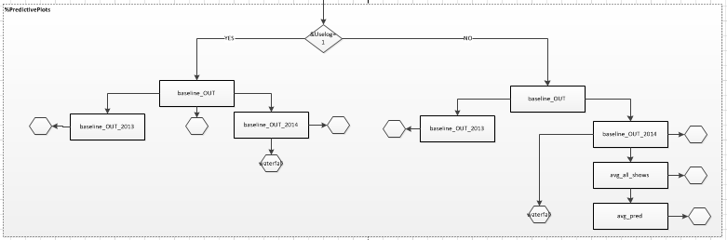
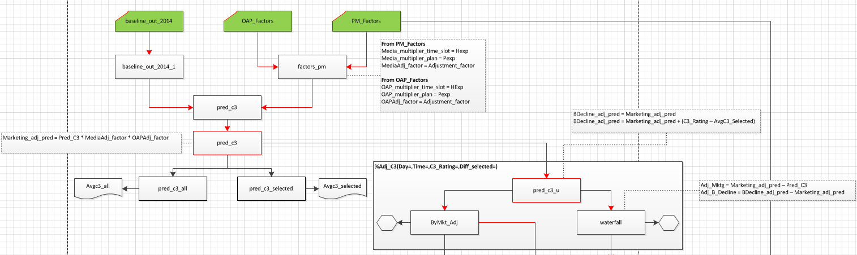
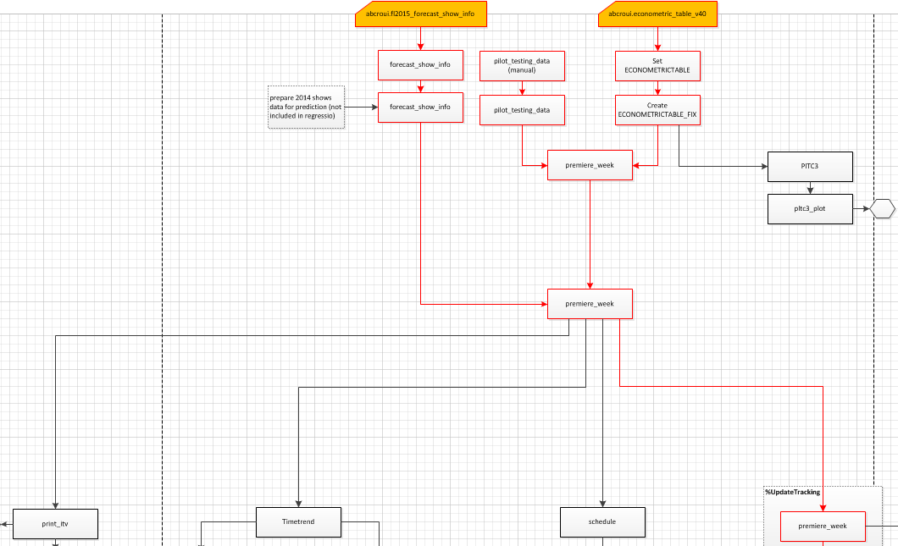
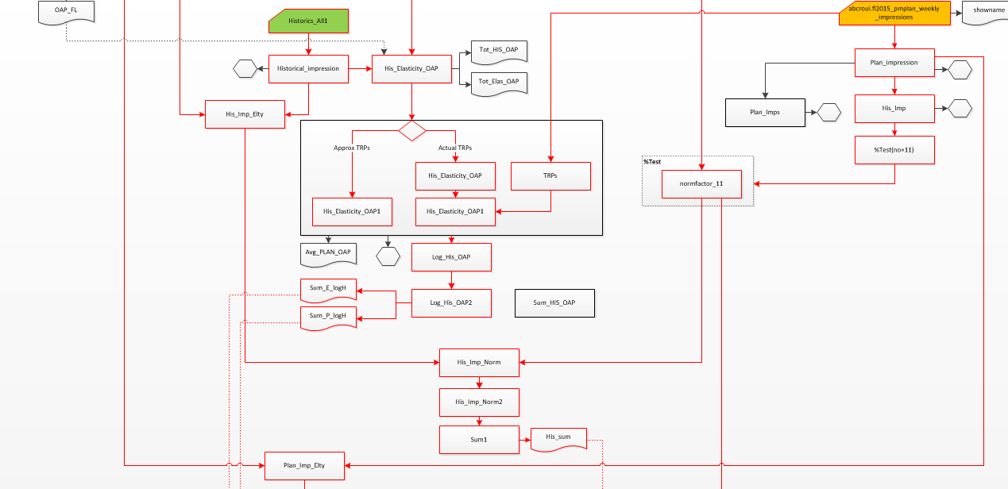
ABC ROI Forecast Pipeline
Old Process New Process
Rating Predications for New Shows
Rating Predications for Returning Shows
Calculate Market Adjustment Factors
Ratings without Marketing Effect
Visualization

Slide 5



ABC ROI Forecast Pipeline
Models
Programming Languages
Data Sets
UCM
OLS
Consumer Response
Marketing
Research
ARIMA
Holt-Winters
Financial Assumptions
Movie Characteristics

Slide 6
Automated Validation System
Design the Validation protocol to normalize the data
Test the protocol to prove it is performing as expected
Generate enough test-cases for all circumstances
Design & Implement Validation Protocol
Validate the Process
Validate the steps across the forecast pipeline
Observe the errors and differences
Generate a Validation Report
Design the validation report
Correct the Anomalies and review the code
Revalidate until Satisfactory Results acheived

Slide 7
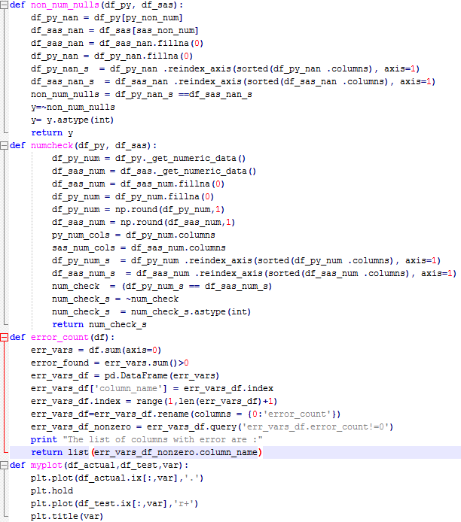
Validation Protocol
Design & Implement Validation Protocol
Validate the Process
Generate a Validation Report

Slide 8
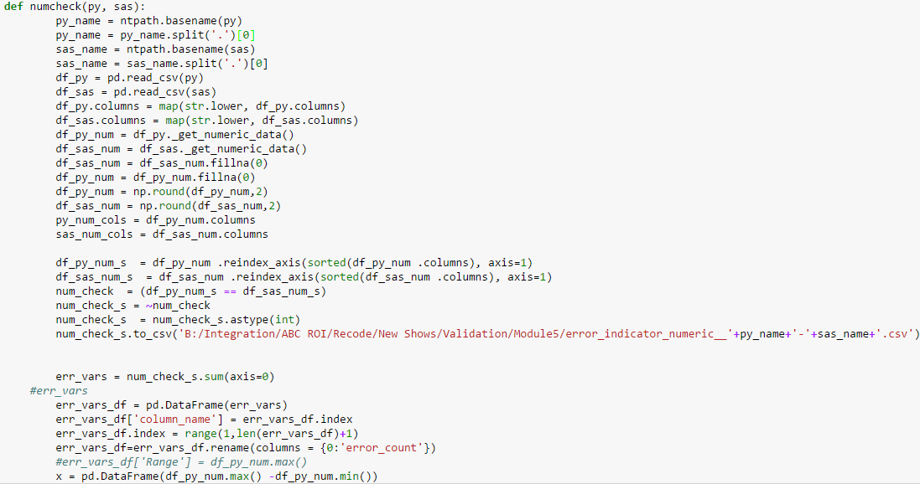
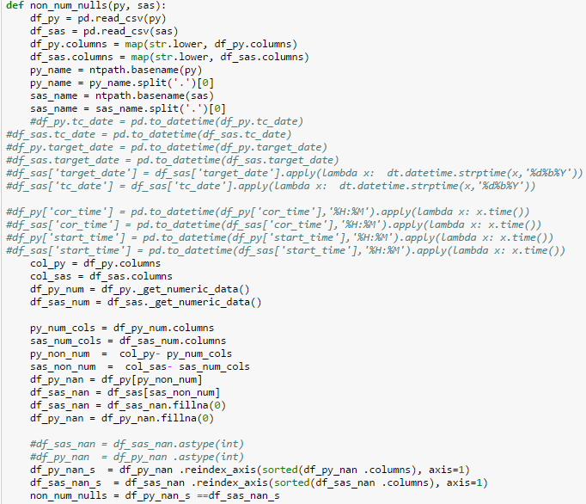
Validation Protocol
Old Dataset
New Dataset
Design & Implement Validation Protocol
Normalize the Data
Validate the Process
Numeric- Comparison
Non-numeric- Comparison
Generate a Validation Report

Slide 9
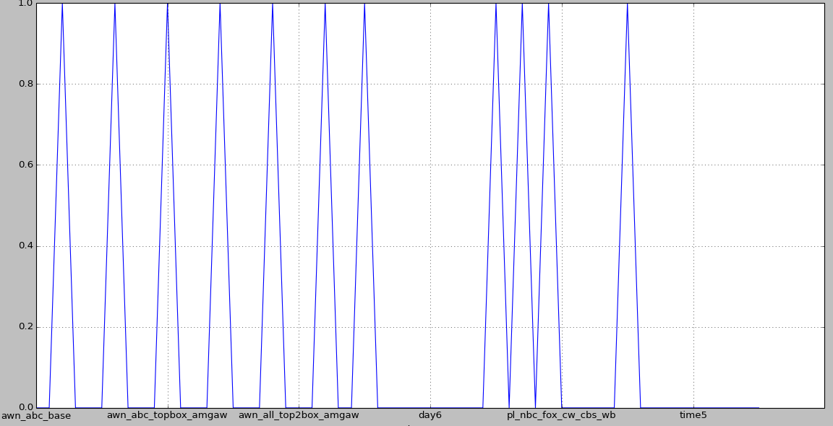
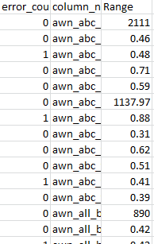
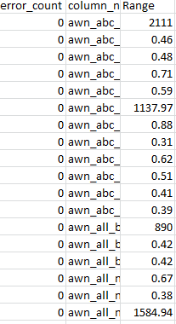
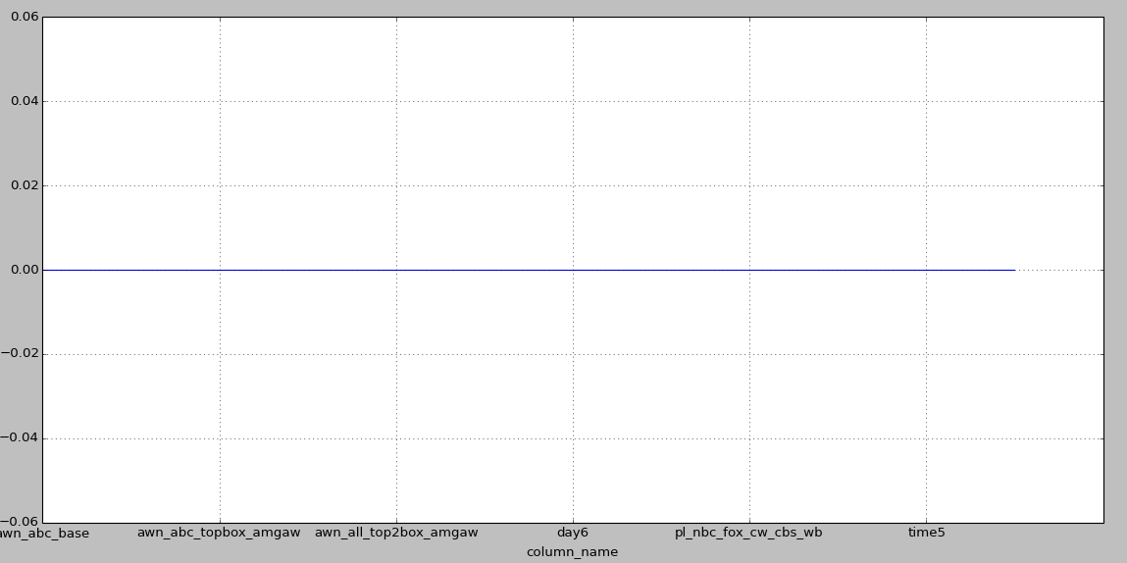
Validation Pipeline
Data with Anomalies
Design & Implement Validation Protocol
Validate the Process
Data without Anomalies
Generate a Validation Report

Slide 10
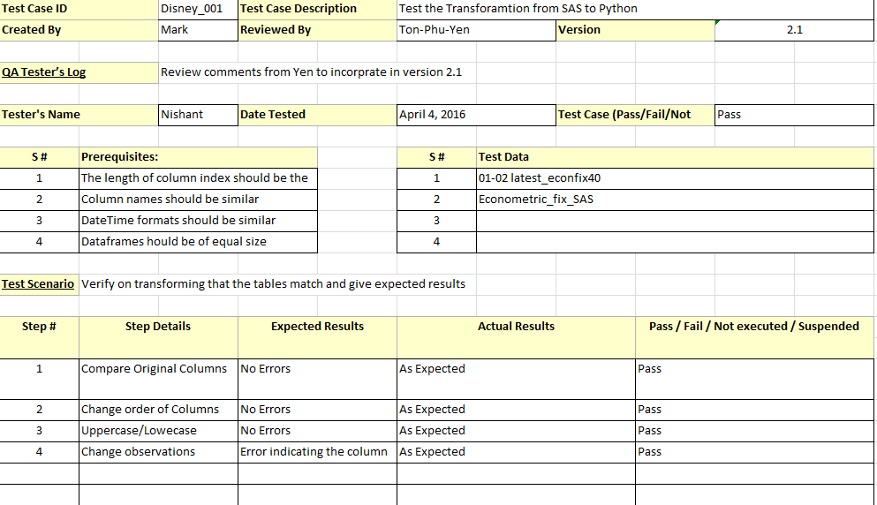
Validation Report
Design & Implement Validation Protocol
Validate the Process
Generate a Validation Report

Slide 11



Expanding Capabilities through Cross Platform Integration
SAS/OR
Statistical Libraries
Web service that encapsulates a SAS procedure in a stored process and execute the web service through a third party client
Libraries that provides an interface to R from Python including wrappers to inbuilt libraries as well as R like structures and functions

Slide 12




Expanding Capabilities with Web Service
Shared Database /Application Server
Unified Platform

Slide 13
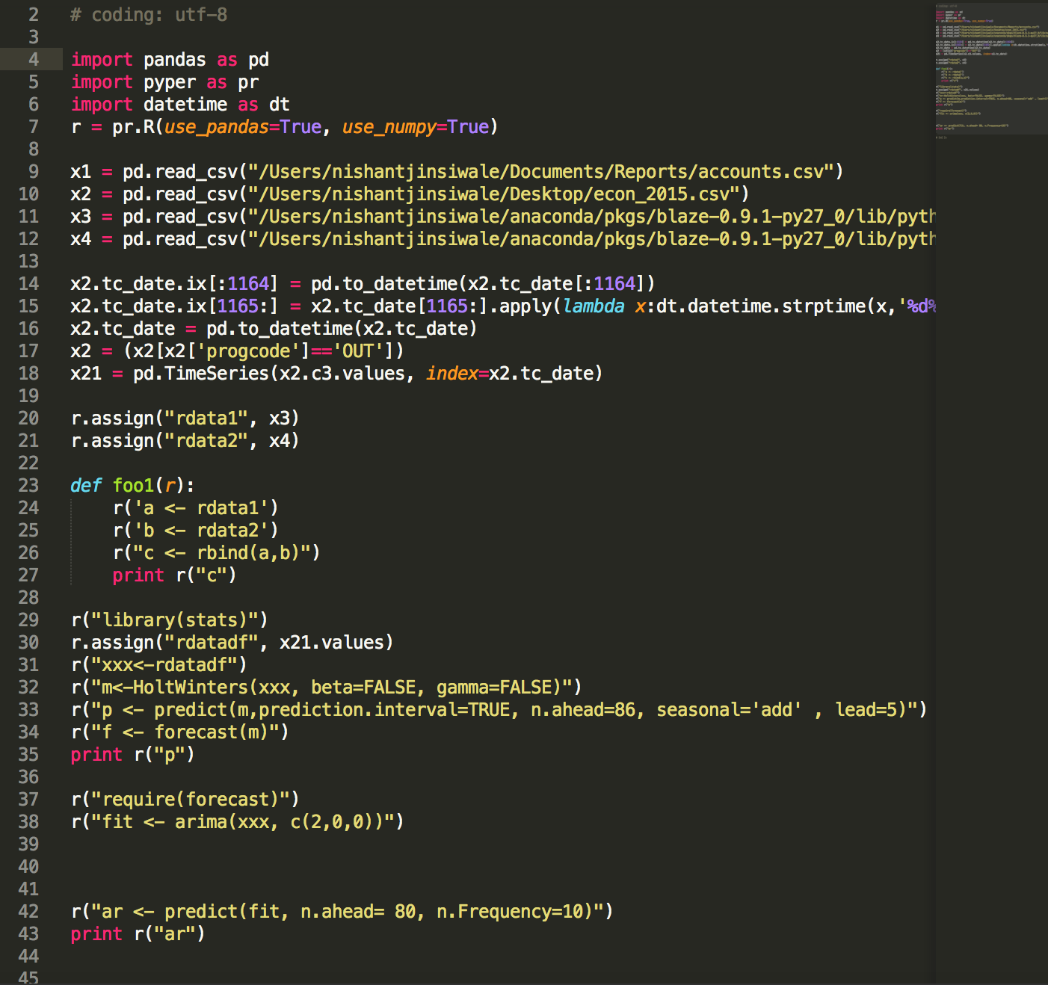
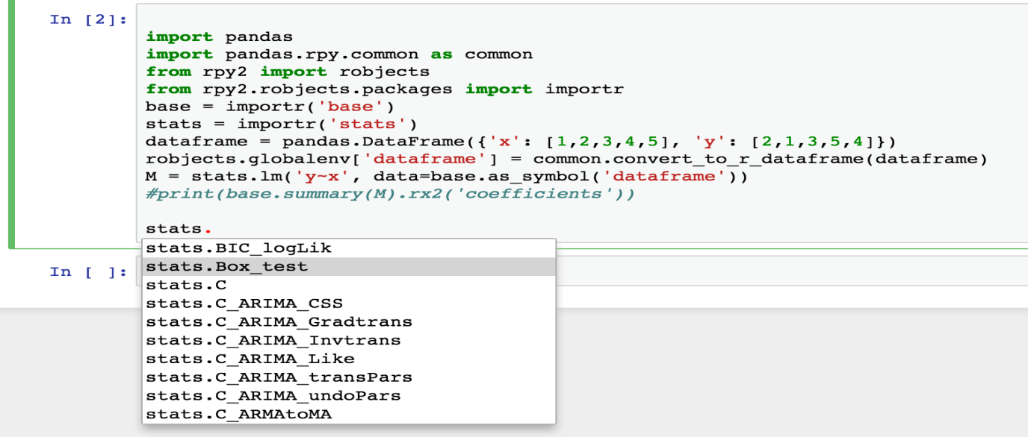
Expanding Python Libraries
PyPer
Vs
RPy

Slide 14
Timeline
Primary Internship Objective :
Extract ABC ROI Methodology for implementation in a unified Platform
January 2016
Feb-Mar 2016
Mar-Apr 2016
Research about Statistical Libraries
Apr-May 2016
Design a Validation System
Familiarity with SAS & Statistics
Research about Python and SAS Integration
Understand company culture
25% Development done
75% Development done
100% Development done

Slide 15
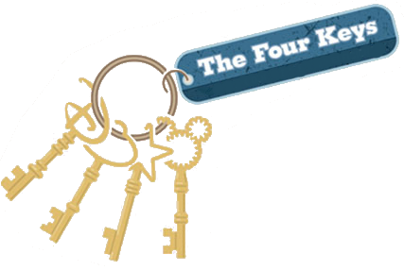

Takeaways
Decision Science
Data
Business
Technology

Slide 16

Conclusion

Slide 17
Thank You !

